Slide 1

课时练习
期中复习五 模块六 第二章

Slide 2
一、根据语境、 音标或所给单词的提示完成句子， 每空一词。
1. Sanya is a popular city for winter ________ /vəˈkeɪʃn/ travel
2. We’ll go _________ (camp) in the mountains this weekend if it’s fine.
3. The sun comes up in the _____ and goes down in the west.
vacation
camping
east

Slide 3
一、根据语境、 音标或所给单词的提示完成句子， 每空一词。
4. Zhong Nanshan ________ (receive) the Medal of the Republic for his contribution(贡献) to fighting COVID-19.
5. “___________ /ɪkˈspɪəriəns/ is the teacher of all things,” said Julius Caesar(凯撒大帝).
received
Experience

Slide 4
二、 重点句型。
1.当你在享受桂林之旅时，我正忙着准备考试。
While you were ______________________ Guilin,
I was busy ________________________________.
2. 他到达时，我想要你和我一起去见他。
I’d like you ____________ with me when he _______.
enjoying your trip to
preparing for my exam(s)
to meet him arrives

Slide 5
二、 重点句型。
3. ——顺便问一下，从这里到天安门广场有多远？
—By the way, _______________ here to Tian’anmen Square?
——骑自行车大约一个半小时。
—It’s about __________________________.
4. 那三个男孩一见面就全都高兴得跳了起来。
____________ the three boys saw each other, they all
_______________________________.
how far is it from
one and a half hours by bike
As soon as
jumped around happily

Slide 6
二、 重点句型。
5.当我们兴致勃勃地游览时，我发现Darren不见了。
While we were ___________________,
I found that Darren _______________.
having fun exploring
was/got lost

Slide 7
三、重点语法。
★时间状语从句
(A)根据所学知识， 将横线上的内容补充完整。
时间状语从句在句子中充当时间状语，可位于主句之前或主句之后。位于主句之前时，常用逗号与主句隔开。引导时间状语从句的从属连词有：
1. when和while

Slide 8
三、重点语法。
●when引导时间状语从句时表示“当……时”， 其动作既可和主句同时发生， 也可以在主句的动作之前或之后发生，在从句中既可用 ______ 性动词也可用 _______ 性动词。如：
My father was reading a newspaper when I arrived home.
When I was doing my homework, my mother came into my room.
延续
非延续

Slide 9
三、重点语法。
●while引导时间状语从句时表示 “在……期间”， 它强调主句的动作和从句的动作 ______ 持续地进行或主句动作是在从句动作进行期间发生的。while引导的时间状语从句中的谓语动词必须是 _____ 性动词。如：
While Kate was reading, her brother was playing with his toys.
同时
延续

Slide 10
三、重点语法。
2. before和after
before引导时间状语从句时表示主句的动作发生在从句动作之 ___， after引导时间状语从句时表示主句的动作发生在从句动作之 ___。如：
I finished my homework before I went to play basketball.
My mother went shopping after she had breakfast.
前
后

Slide 11
三、重点语法。
3. until
在until引导的时间状语从句中，主句的动作持续到从句动作发生为止。其常用结构not … until … 表示 “直到……才(开始)……”。如：
I didn’t go to bed until my mother came back.

Slide 12
三、重点语法。
4. as soon as
as soon as引导的时间状语从句表示从句的动作一发生，主句的动作随即发生，意为 “一……就……”。如：
Our neighbors made us welcome as soon as we arrived.
注意：在含有时间状语从句的主从复合句中，如果主句和从句都表示将要发生的动作，主句通常用 ______时，从句用 ______ 时代替 ______ 时。如：
I will call you as soon as I get to Beijing.
一般将来
一般现在
一般将来

Slide 13
三、重点语法。
(B)根据中文提示完成句子。 (每条横线不限词数。)
1. 昨天我们一到公园就开始放风筝。
We began to __________________________________
_____________________________________________.
2. 当老师走进教室时，学生们正在朗读英语。
When the teacher came into the classroom,
____________________________________________.
fly kites as soon as we got to/arrived at the park yesterday
the students were reading English

Slide 14
三、重点语法。
(B)根据中文提示完成句子。 (每条横线不限词数。)
3. 当我妈妈正在厨房做饭时，电话响了。
The telephone rang ____________________
_____________________________________.
4. 直到雨停了，我们才离开教室。
We ____________________________ the rain stopped.
when/while my mother
was cooking in the kitchen
didn’t leave the classroom until

Slide 15
三、重点语法。
(B)根据中文提示完成句子。 (每条横线不限词数。)
5. 你离开上海前能与我见个面吗？
Can you meet me ________________________?
before you leave Shanghai

Slide 16
四、单项选择。
( )1. —Do you know where Xishuang Banna is?
—Of course. It’s ___ the southwest of China.
A. in B. on C. to
A

Slide 17
四、单项选择。
( )2. —The 2022 Beijing Winter Olympics is around the corner.
—Yes. I can’t _____ for it!
A. push B. look C. wait
C

Slide 18
四、单项选择。
( )3. We should always keep a clear head _____ judging(评判) what we see on the Internet.
A. when B. until C. after
A

Slide 19
四、单项选择。
( )4. —_____ is the railway station from here?
—About ten minutes’ walk.
A. How long
B. How soon
C. How far
C

Slide 20
四、单项选择。
( )5. —I don’t think this is the right way to the museum.
—Let’s stop and ask for ______ then.
A. directions B. experiences C. conditions
A

Slide 21
四、单项选择。
( )6. —Why can’t Jane help clean the room?
—Because she is busy ____ the math problem.
A. working on
B. going on
C. putting on
A

Slide 22
四、单项选择。
( )7. My father was watching a soccer game while I ____ to music.
A. am listening
B. was listening
C. listened
B

Slide 23
四、单项选择。
( )8. The streets in the city center are ____ traffic from morning till night.
A. proud of B. full of C. fond of
B

Slide 24
四、单项选择。
( )9. —Don’t rush into a decision. Just take it ____.
—OK. Thanks for your advice.
A. quickly B. safely C. slowly
C

Slide 25
四、单项选择。
( )10. —_____. You found the key I lost.
—Happy to help.
A. Good luck
B. You’re welcome
C. Thank goodness
C

Slide 26
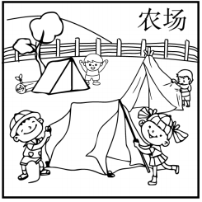
五、看图写话。
1. on, yesterday
The kids went camping on a farm yesterday./
They camped on the farm yesterday.

Slide 27
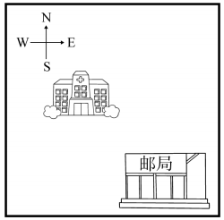
五、看图写话。
2. northwest
The hospital lies/is to the northwest of the post office.

Slide 28
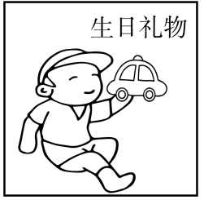
五、看图写话。
3. on
The boy/He received/got a toy car on his birthday.

Slide 29
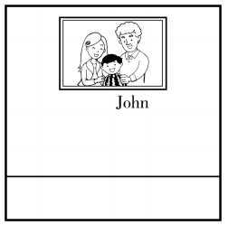
五、看图写话。
4. there be, wall
There is a photo of John’s family on the wall.

Slide 30
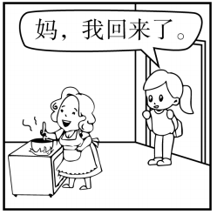
五、看图写话。
5. when
When the girl came back home, her mother was cooking.

Slide 31
六、情景交际。
1. 你想知道朋友愿不愿意帮你制定一个旅行计划，可以这样问：
Could ___________________________________?/
Could ___________________________________?
2. 你想知道当你在图书馆备考时对方在做什么，可以这样问：
_________________________________________________
in the library?
you help me plan a trip
you help me work out a travel plan
What were you doing while I was preparing for the exam

Slide 32
六、情景交际。
3. 即将和分别多日的朋友见面， 你可以这样在信中表达自己的期待：
I’m ____________________________________.
4. 你昨天去探索博物馆时玩得很开心，可以这样告诉同桌：
________________________________________.
5. 你想告诉朋友你的家乡因制伞而出名， 可以这样说:
My hometown is __________________________.
looking forward to seeing you
I had fun exploring the museum yesterday
famous for making umbrellas

Slide 33
七、短文填空。
Many children like to go to museums. The Shanghai Science and Technology(技术) Museum had many visitors on Monday. Why? Because it was the 1 (one) day of the National Day holiday in China. Many parents took their children to 2 . museum.
first
the

Slide 34
七、短文填空。
The “Trip of Food” was 3 /ˈpɒpjələ(r)/ with visitors. They could take the fruitshaped cars to go on an 4 (interest) trip. But visitors had to wait for an hour to ask 5 the ride. Zhang Hui took his son to 6 /ɪkˈsplɔː(r)/ the “Rainbow Kid Garden”. The things in it were like wind and sound, and people could learn about them through games. “Though my son is too young to
7 /ˌʌndəˈstænd/ them, it’s good for him,” said Zhang.
popular
interesting
for
explore
understand

Slide 35
七、短文填空。
“We try to teach children through games. In this way, children will show more interest in 8 . (learn),” said a worker.
There were some volunteers(志愿者) working in the 9 . Fu Xiangdong became a volunteer ten years ago. Fu can answer visitors’ questions 10 . (quick). “Working as a volunteer, I feel quite happy,” said Fu.
learning
museum
quickly

Slide 36
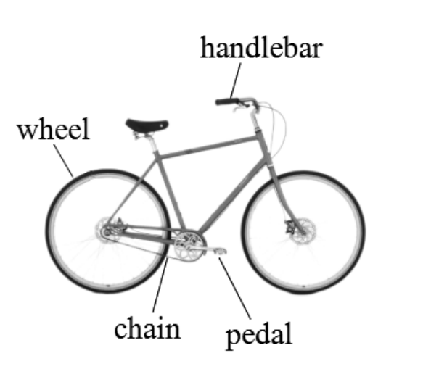
八、阅读理解。
In the 1790s, a Frenchman invented the world’s first bicycle. It was made out of wood. It had no pedals, so people had to use feet to ride it. It also had no handlebars, so people couldn’t steer it—they would have to go straight(笔直地) ahead.

Slide 37
八、阅读理解。
In 1817, Baron Karl, from Germany, invented a new kind of bike. The bicycle was wooden with two wheels, a seat and handlebars. It was the fastest thing of its time. But it had no pedals, either. Again， people would use their feet and push while the wheels rolled(滚动) on the ground.

Slide 38
八、阅读理解。
In 1870, an Englishman named James Starley made a bicycle with a large front wheel and a small back wheel. The front wheel was as high as the rider’s leg length(长度). This kind of bicycle was very dangerous because if the rider was to stop, he or she could fall backwards. Also, it was dangerous to go down a hill.

Slide 39
八、阅读理解。
The first bicycle with a chain was made in 1874 by a UK bicycle designer H. J. Lawson. The bicycle was made up of two wheels of the same size and a chain on the back wheel. It was called the safety bicycle. It started to gain in popularity in the beginning of the late 1880s, and is now the most common type of bicycle.

Slide 40
八、阅读理解。
( )1. The underlined part “steer it” in the first paragraph means “______”.
A. ride the bike
B. stop the bike
C. move the bike forward
D. control the direction of the bike
D

Slide 41
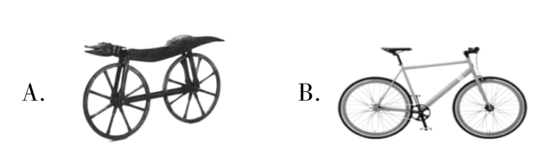
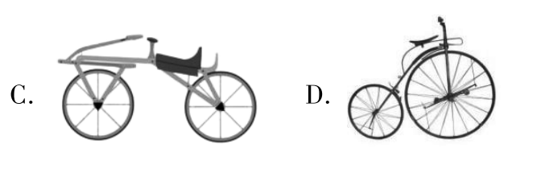
八、阅读理解。
( )2. James Starley’s bicycle may look like the one in Picture _____.
D

Slide 42
八、阅读理解。
( )3. The safety bike first appeared _______.
A. in the 1790s
B. in the 1810s
C. in the 1870s
D. in the 1880s
C

Slide 43
八、阅读理解。
( )4. Which of the following is TRUE according to the passage?
A. The bicycle was first invented in Germany.
B. The bicycle first appeared with no seat.
C. The bicycle with no handlebars is very safe.
D. The safety bicycle is now the most common type.
D

Slide 44
八、阅读理解。
( )5. The passage is mainly about _____.
A. four famous inventors
B. the history of bicycles
C. necessary bicycle parts
D. the world’s fastest vehicle
B

Slide 45


